Slide 1
Categorizing YouTube Videos
Nitesh Gupta
Tanmay Gore

Slide 2
Why Cluster Youtube Videos?
Benefits:
Monetary Benefits
Video Recommendation
Why Clustering:
Video Categories might not be known beforehand.
Can consider metadata for classification

Slide 3
TFIDF
Data Set contains following features:
Title
Tags
Description
Converts text to numbers
Prioritizes meaningful information over stop words
Result – 50,000 dimensions

Slide 4
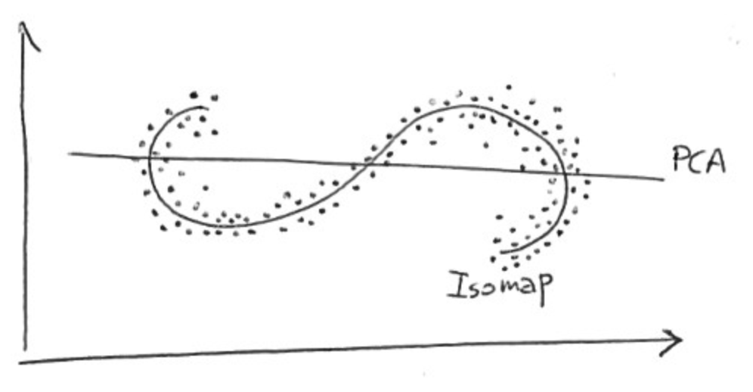
Isomap
NON LINEARITY DIMENSION REDUCTION METHOD
components of the low-dimensional vector are given by NON linear functions of the components of the corresponding high-dimensional vector.
https://stats.stackexchange.com/questions/124534/how-to-understand-nonlinear-as-in-nonlinear-dimensionality-reduction

Slide 5
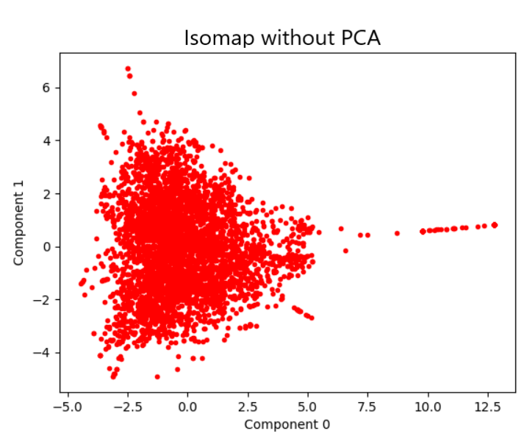
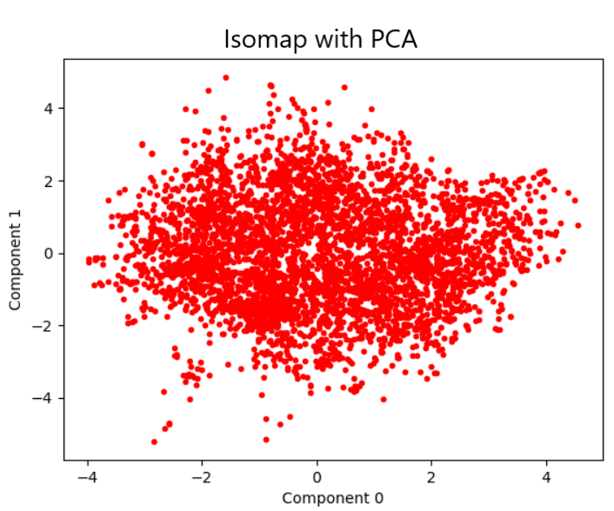
PCA
Dimensionality Reduction
Reduces 50, 000 dimensions to 3000 with only 5% loss of information.

Slide 6
KMeans
Centroid based clustering

Slide 7
Performance Measure
Silhouette Coefficient

Slide 8
Agglomerative Hierarchical Clustering (AHC)
WHY Hierarchical Clustering
NUMBER OF CLUSTERS NOT KNOWN BEFOREHAND IN SEVERAL DATA ANALYSIS PROBLEM
TWO TYPES
TOP DOWN : START WITH A ONE LARGE CLUSTER
BOTTOM UP : INITALIZE EACH DATA POINTS AS ITS OWN CLUSTER AND RECURSIVELY MERGE THE CLUSTERS
CLUSTER DISTANCE
SINGLE LINKAGE
COMPLETE LINKAGE
AVERAGE LINKAGE
WARD LINKAGE : minimizes the total within-cluster variance
Notes:
Greedily form data clusters based on local correlations between the data points.
At each step find the pair of clusters that leads to minimum increase in total within-cluster variance after merging.

Slide 9
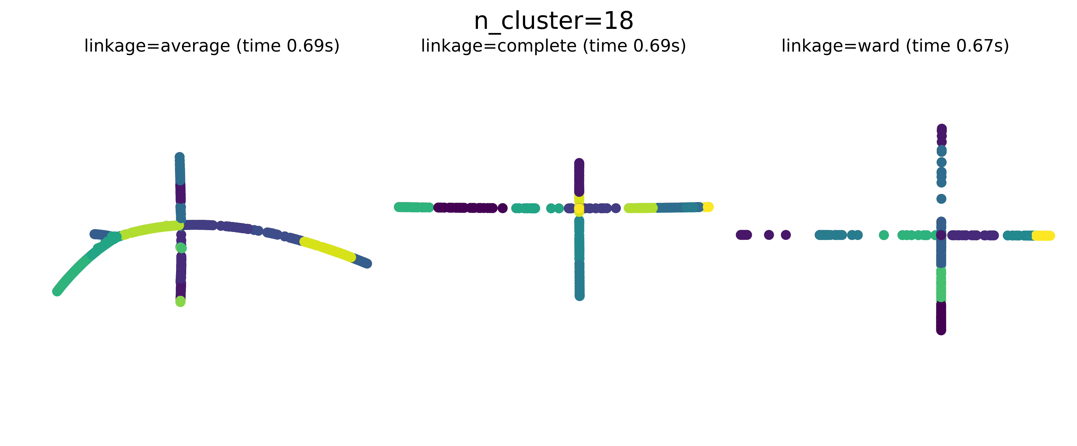
RESULTS
AHC

Slide 10
CONCLUSION
AHC
Number of Cluster=18, linkage = ward, Silhouette Coefficient: 0.023, Training time: 0.67 s
K MEANS

Slide 11
REFERENCES
LECTURES SLIDES BY DR. CHINMAY HEGDE FOR EE 525X SPRING 2018, IOWA STATE UNIVERSITY
https://en.wikipedia.org/wiki/Isomap
https://stats.stackexchange.com/questions/124534/how-to-understand-nonlinear-as-in-nonlinear-dimensionality-reduction
https://en.wikipedia.org/wiki/Hierarchical_clustering

